Slide 1
Datacaptatie & visualisatie
Intro Node-RED

Slide 2
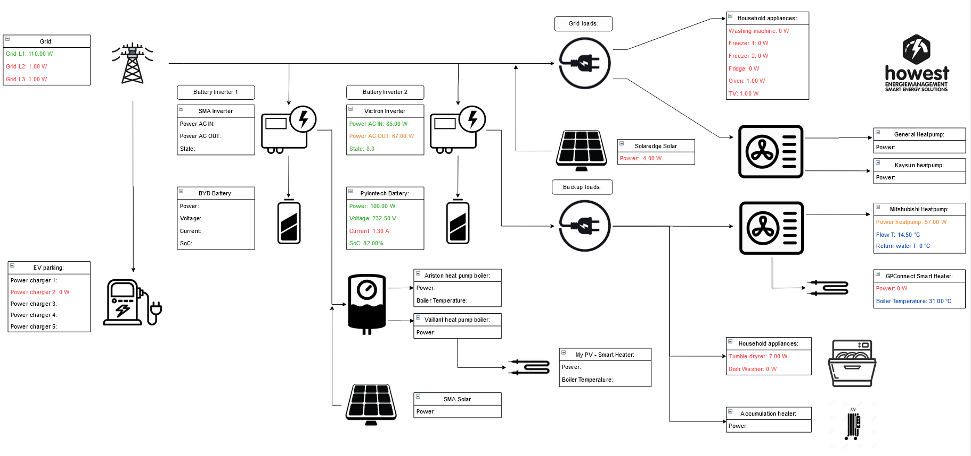

Problem
Intro
A lot of technologies for EMS (Energy Management Systems)
Can one make a controller with current systems by exchanging data with each other?
Load park
Smappee EV charger
3 battery storage
Victron, SMA, Varta
2 heatpump boilers
Ariston, Vaillant
1 air/Water heatpump
Mitsubishi
2 air/air heatpumps
Kaysun, General
2 smart resistor controllers
GPC, My PV
1 PV-installation
Solaredge
2 types sun collectors
Accumulation heating
classic household appliances
# EMS systems

Slide 3
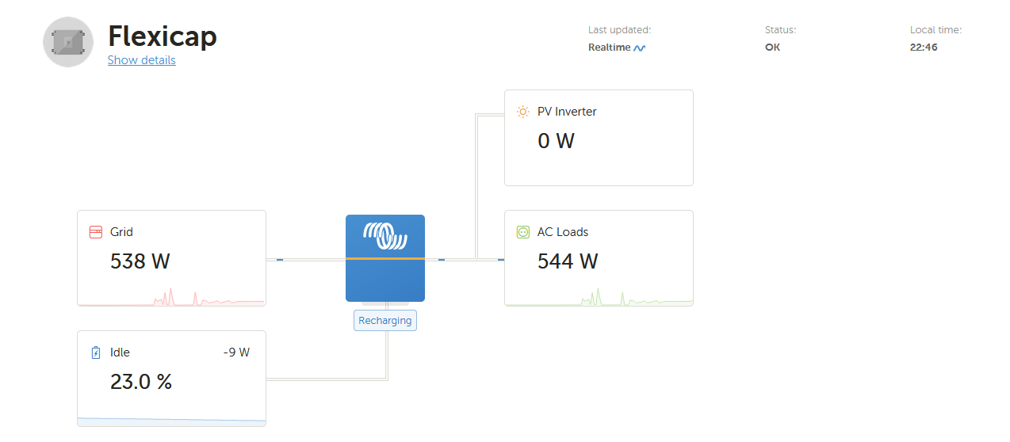
Problem
Every device has its own solution
Example .. Battery storage Victron

Slide 4
Intro Node-RED
Powerful tool for building IoT applications.
Visual programming : wiring together code blocks known as nodes.
Developed as an opensource project at IBM in 2013.
Useful for a range of applications.
Browser-based flow editor.
JavaScript functions can be created.
A built-in library
Built on Node.js (event-driven, non-blocking model)
Flows are stored in a JSON format.

Slide 5
Node-RED and IoT
Rapid application devopment
Powerful and flexible
Flow-based programming => Messages representing events between nodes.
Not first choice for:
Complex multi-function => complex to visualize
Flow-based programming is cumbersome when handling loops
Data analytics or build User Interface development
E.g.
Use weather webrequest to control shutters
Use fitbit to send email to activate the user
Charge battery when electricity prices are low

Slide 6
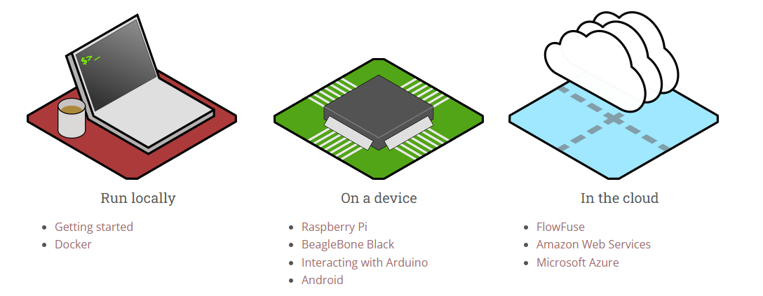
Intro Node-RED
Run at the edge of the network on low-cost hardware as well as in the cloud.

Slide 7
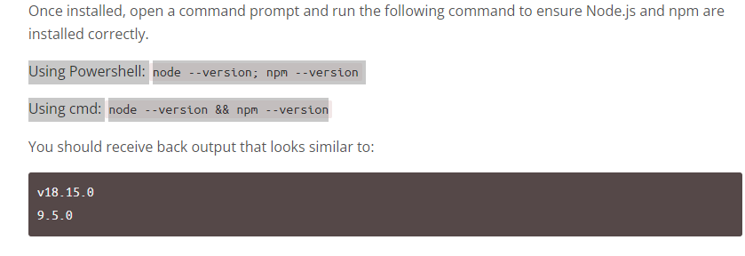
Native installation on Windows
https://nodered.org/docs/getting-started/windows
Install Node.js => https://nodejs.org/en/
Check the Node.js installation
Install Node-RED
Installing Node-RED as a global module adds the command node-red to your system path. Execute the following at the command prompt:
npm install -g --unsafe-perm node-red

Slide 8
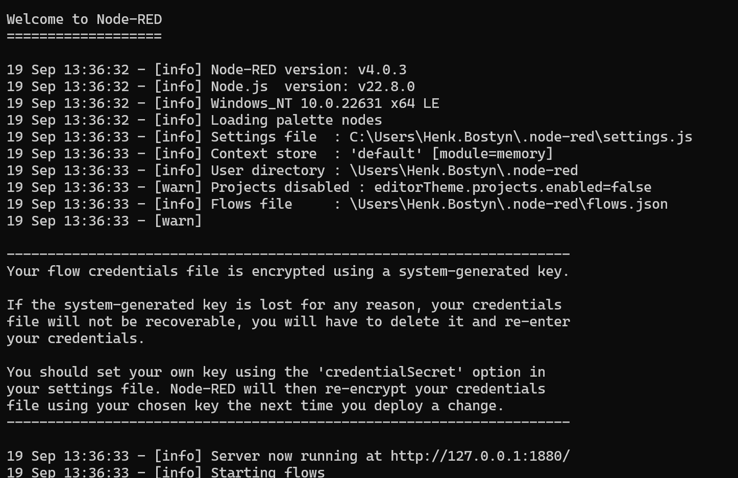
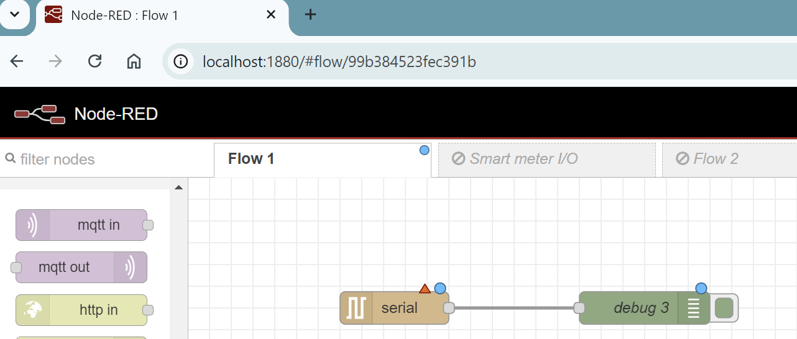
Running on Windows
Once installed, the simple way to run Node-RED is to use the node-red command in a command prompt: If you have installed Node-RED as a global npm package, you can use the node-red command:
C:>node-red
This will output the Node-RED log to the terminal. You must keep the terminal open in order to keep Node-RED running. http://<ip-address>>:1880

Slide 9
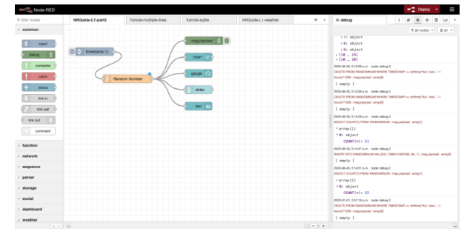
The Node-RED UI
The Node-RED UI consists of three main panes.
The node palette (left)
The flow canvas (centre)
The output pane (right)

Slide 10
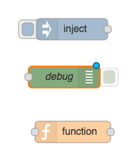
Node-RED nodes
Input Nodes (e.g. inject,connect to services)
Output Nodes (e.g. debug,tcp, email)
Processing Nodes (e.g. function)
Small grey square => input/output endpoints
Some nodes have a button to actuate or to enable/disable the node.
Small blue circle => flow needs to be updated

Slide 11
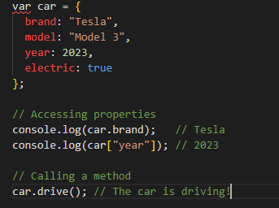
Java script object
An object is a special data structure that lets you store values in key-values pairs.
A key (also called a property name) is usually a string.
A value can be anything: a number, string, array, function, or even another object.

Slide 12
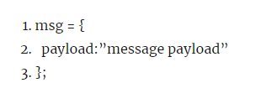
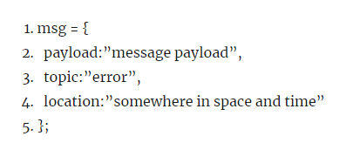
Messages
Node-RED nodes consume input messages and produce output messages.
Messages are JavaScript objects than contain a least a “payload” parameter.
Extend messages

Slide 13
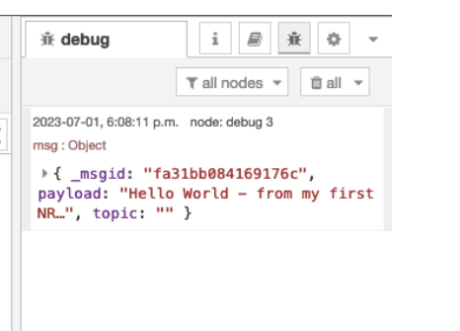
Message
Messages contain:
payload
topics
internal identifier
Message is a JSON object

Slide 14
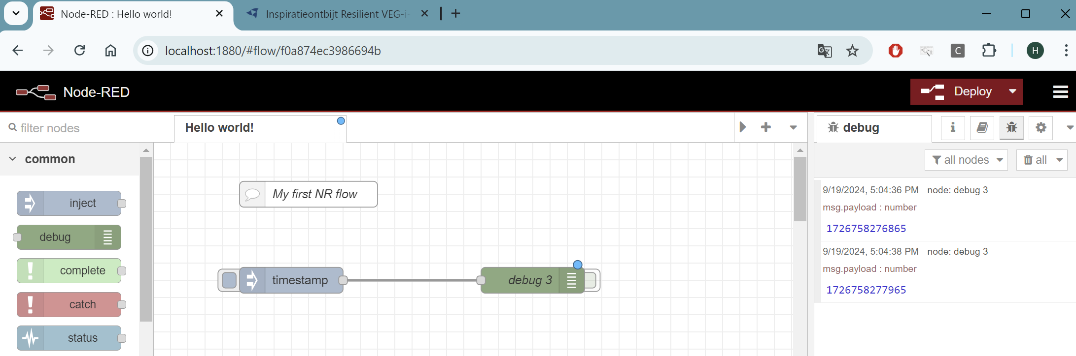
First flow : Hello world
Demo:

Slide 15
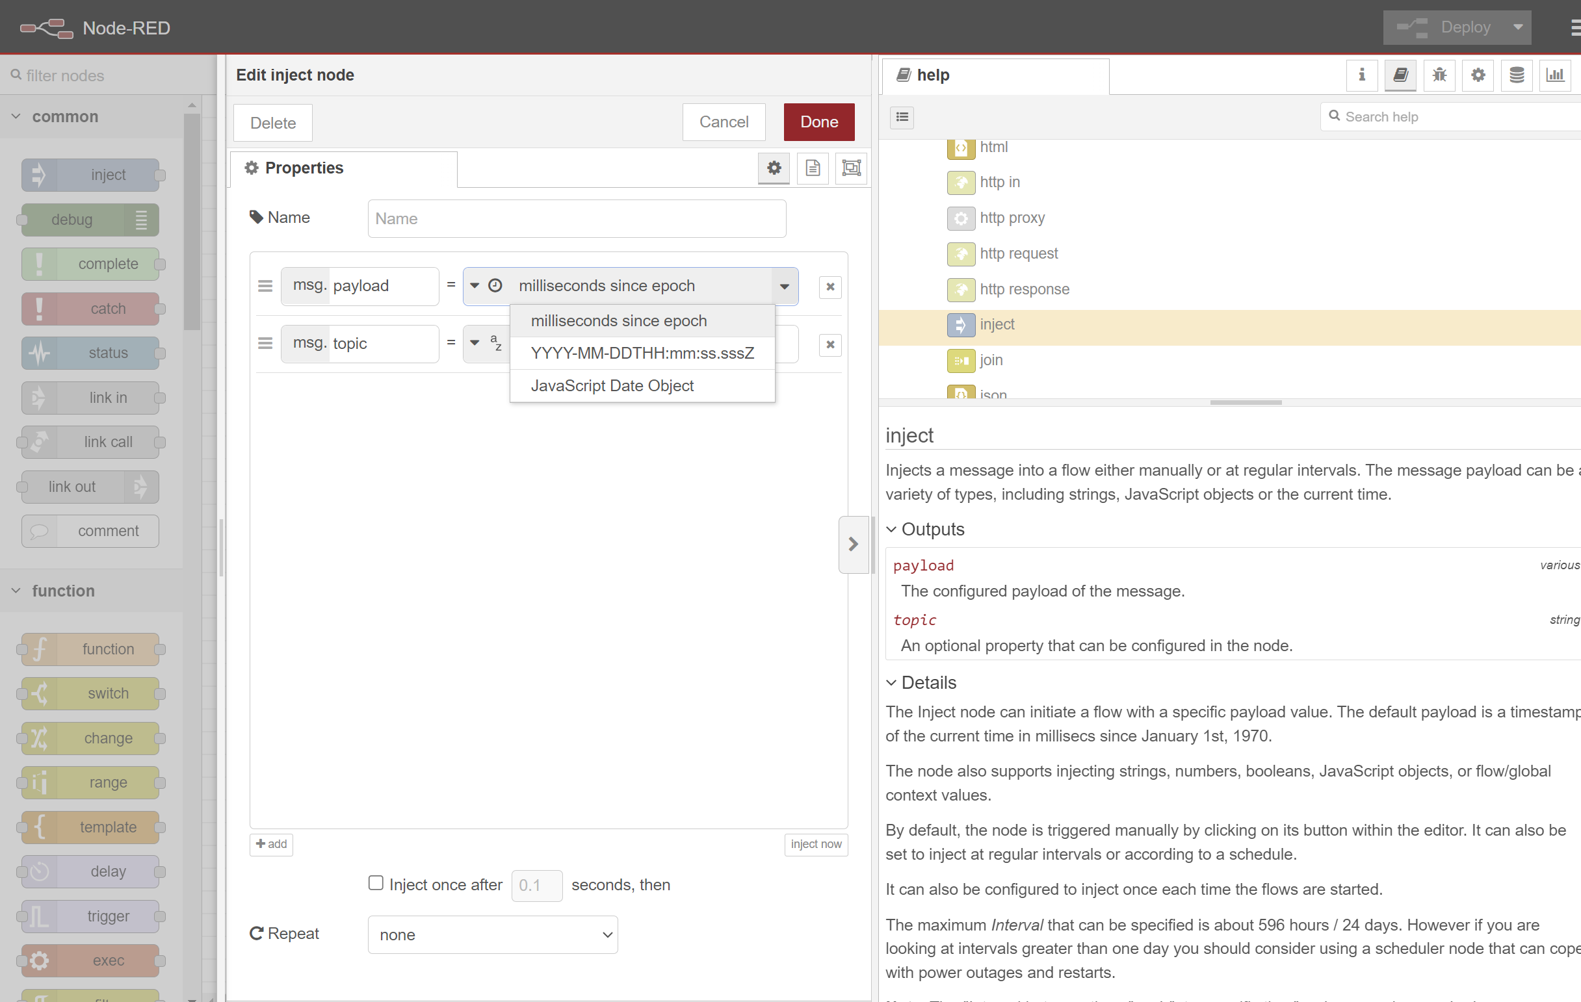
First flow : Info & Help

Slide 16
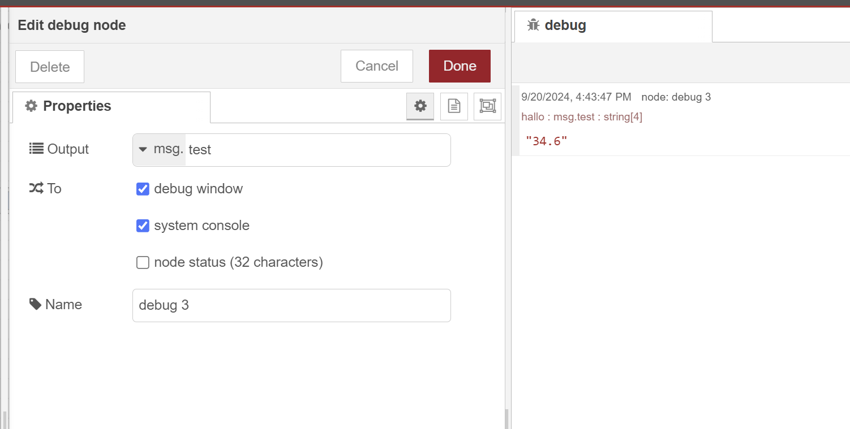
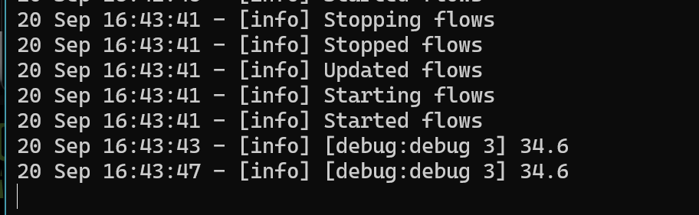
First flow : Debug

Slide 17
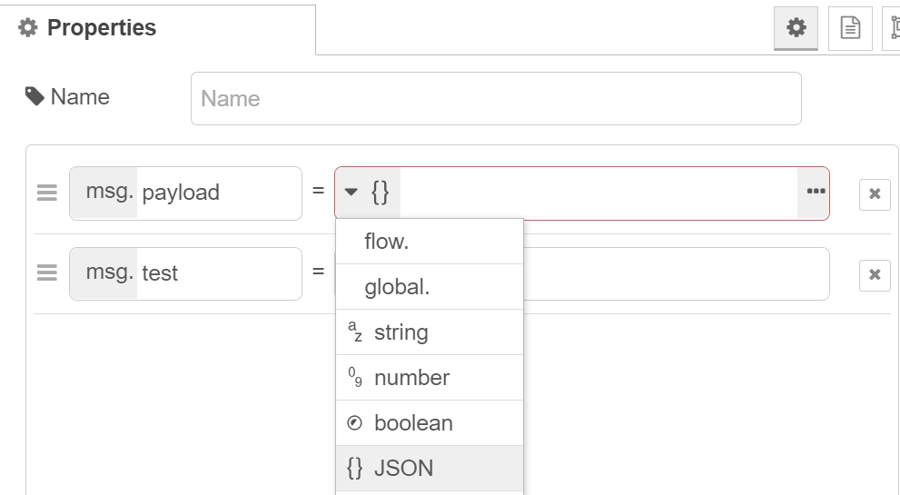
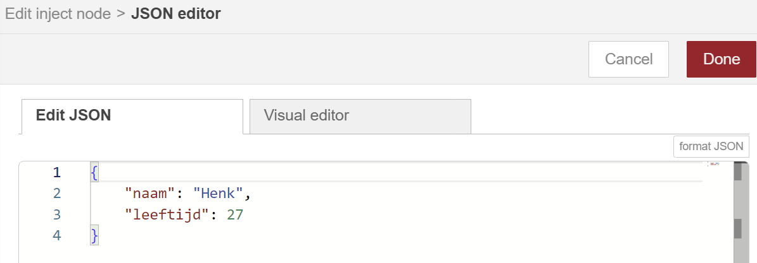
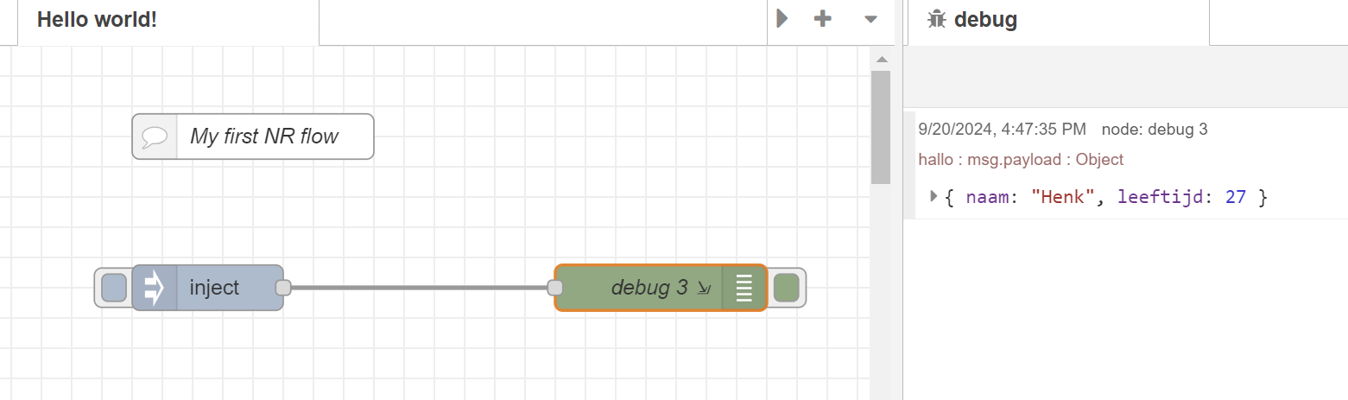
First flow => JSON object

Slide 18
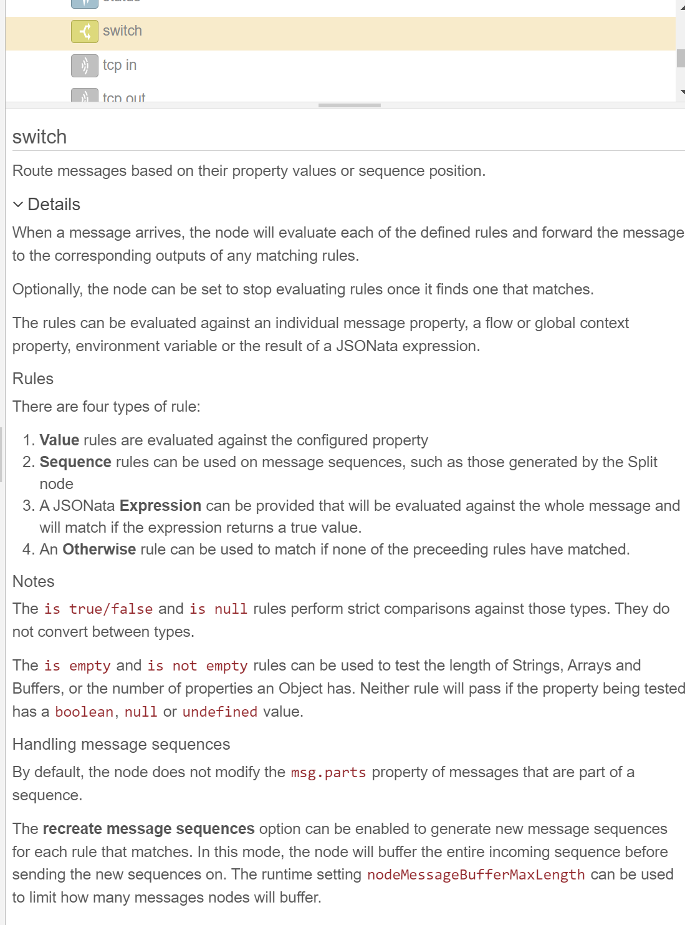
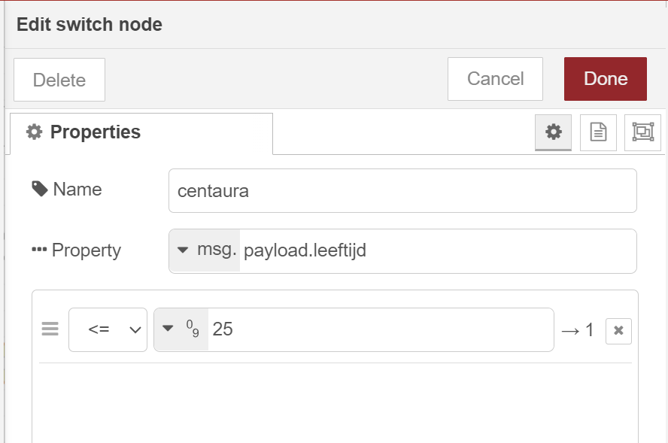
Node-RED => switch
Route messages based on their property values or sequence position.

Slide 19
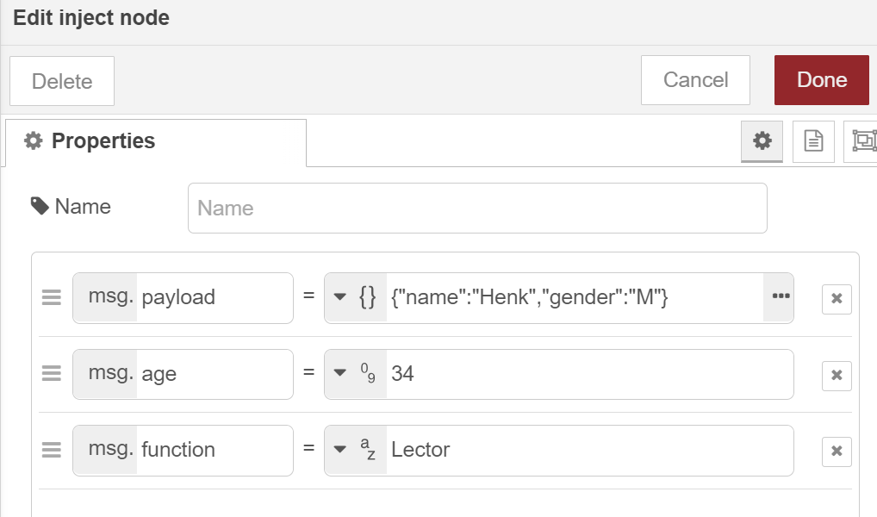
Exercise : switch with topics and JSON
Create an injection node with a few topics and JSON object in the payload.

Slide 20
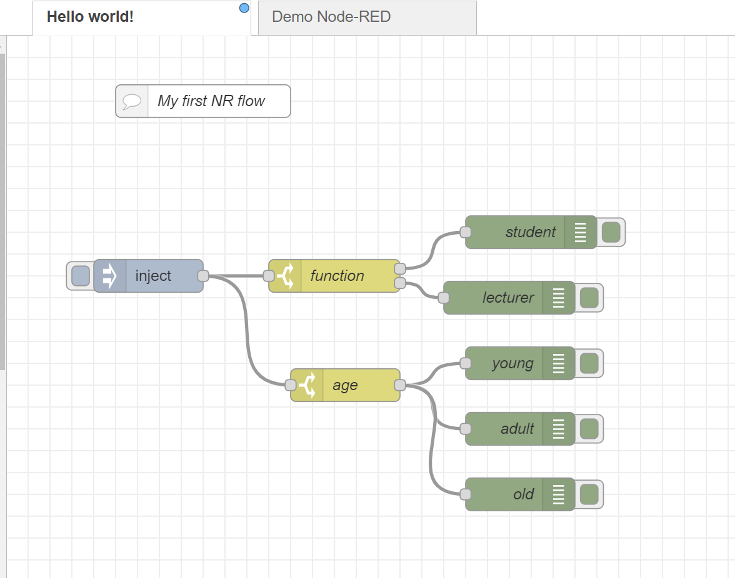
Exercise : switch with topics and JSON
Use a switch node to check the gender of the persons.
Use a switch node to divide up the age
Make a division between lectures and students

Slide 21
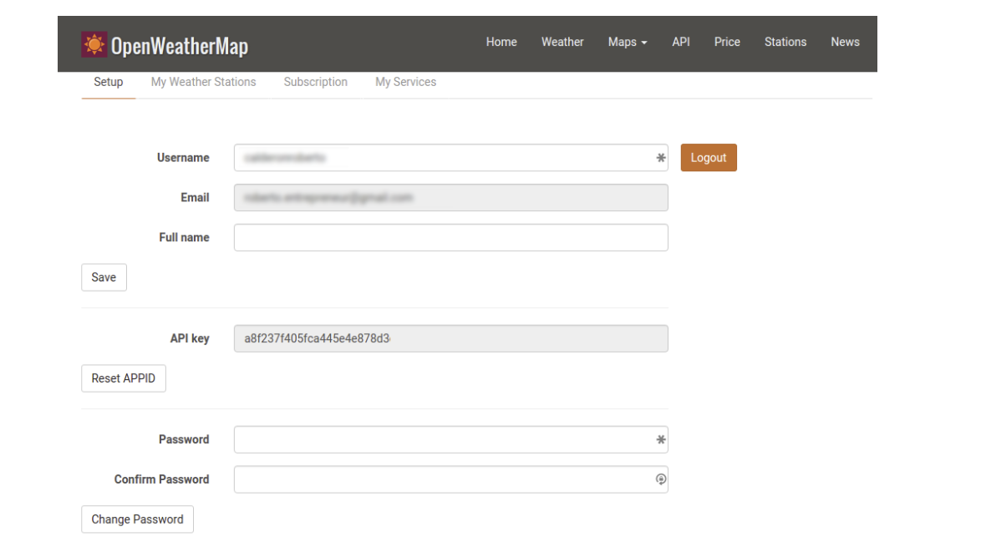
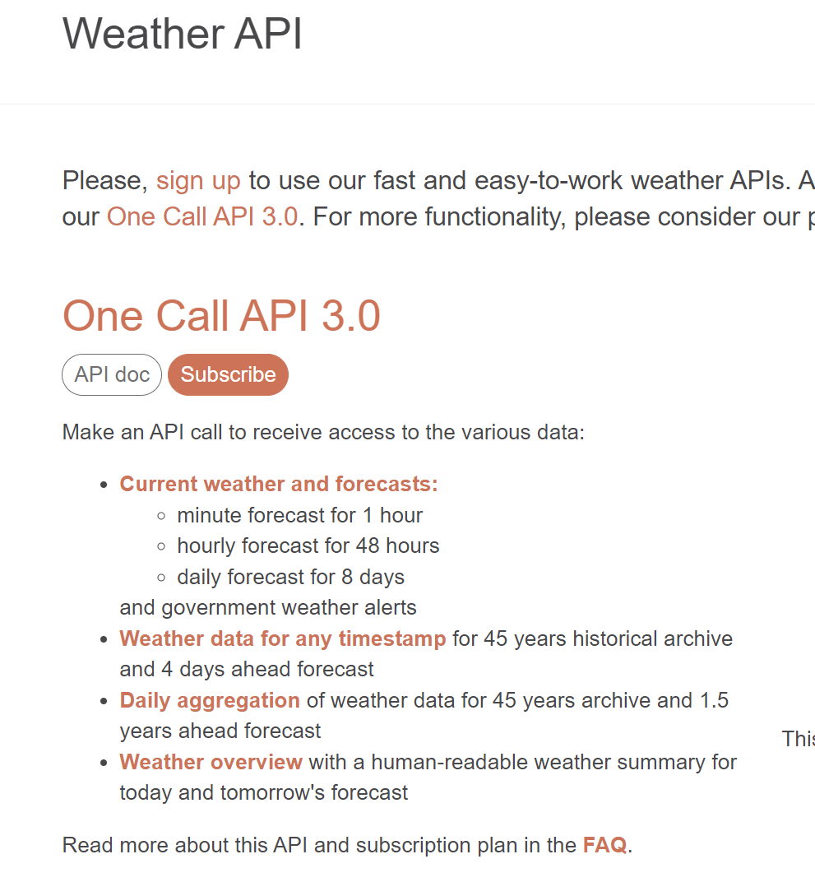
Exercise : openweather
Create an account => we can use the openweather api
It can take an hour before your account is activated
https://openweathermap.org/api

Slide 22
Sources
https://nodered.org/
https://nodered.org/docs/tutorials/
https://noderedguide.com/
https://dashboard.flowfuse.com/

